Slide 1

RAJIV GANDHI UNIVERSITY OF KNOWLEDGE &TECHNOLOGIES ONGOLE CAMPUS ONLINE TRANSACTION FRAUD DETECTION
Presented By
Aparna Malineni
ID.NO:-O180825
CSE3
RGUKT, Ongole.
Under the guidance of
Mrs.S.Nagamani,M.Tech,(Ph.D)
Assistant Professor,
Department of CSE,
RGUKT,Ongole .

Slide 2
AGENDA
Abstract
Objective
Introduction
Existing system and its limitation
Proposed system
Proposed system methodology/framework
Result
Conclusion
Future scope

Slide 3
ABSTRACT
This project aiming to mitigate financial losses and protect both consumers and businesses.
Using historical dataset ML algorithms are designed to identify patterns & anomalies in transaction.
Logistic regression, Decision trees methods are trained to classify transactions as fraudulent or legitimate.

Slide 4
Objectives
Develop and implement an effective machine learning-based fraud detection system for online payment transactions.
exploring multiple algorithms,
conducting feature engineering,
optimizing model performance, to detect and prevent fraudulent activities
It maintaining a high level of accuracy

Slide 5
Existing System
The existing system is detecting the fraud after fraud has been happen.
Existing system maintain the large amount of data when customer comes to know about inconsistency in transaction, he/she made complaint and then fraud detection system start it working.
In case of existing system there is no confirmation of recovery of fraud and customers satisfaction.

Slide 6
LIMITATIONS
Technical difficulties…
Threats to passwords…..
Cost of fraud…
Security concerns…
Lack of technology literacy…
Time and amount restrictions…
Service charges and other expenses….

Slide 7
Proposed System
The aim of the proposed system is to develop a website which has capability to restrict and block the transaction performing by attacker from genuine user’s credit card details.
The proposed system tries to detect fraudulent transaction . In proposed system, while registration we take required information which is efficient to detect fraudulent user activity .

Slide 8
It detects the fraud transactions with high accuracy.
Because we maintain large amount of real world dataset.
Here we implement speech recognition for detecting the fraud transaction.
It tries to find any anomaly in the transaction based on the spending profile of the cardholder , shipping address, and billing address, etc.

Slide 9
Technologies Used
Html
Css
Javascript
Flask
Logistic regression
Python and its Libraries

Slide 10
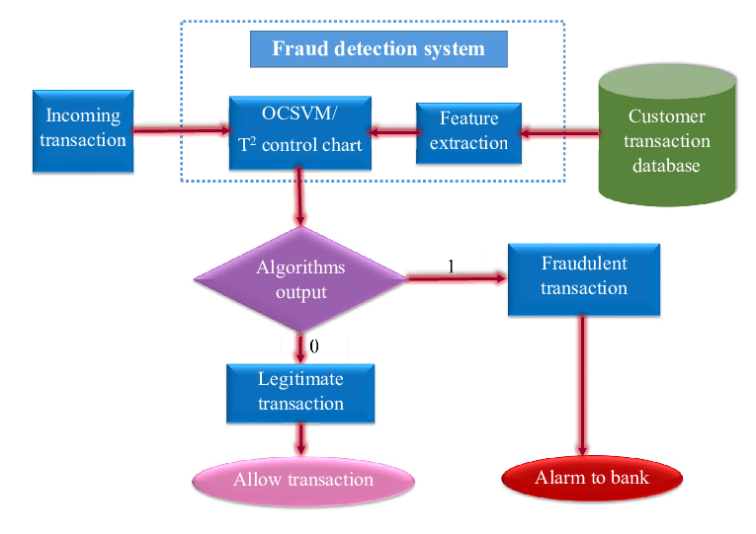
PROPOSED WORK METHODOLOGY/ FRAMEWORK

Slide 11
Result
This project aimed to develop an online payment fraud detection system using machine learning techniques.
ML algorithms like logistic regression & Decision Tree were used to detect the fraud.
By leveraging advanced algorithms and data analysis, the system showed promising results in accurately.

Slide 12
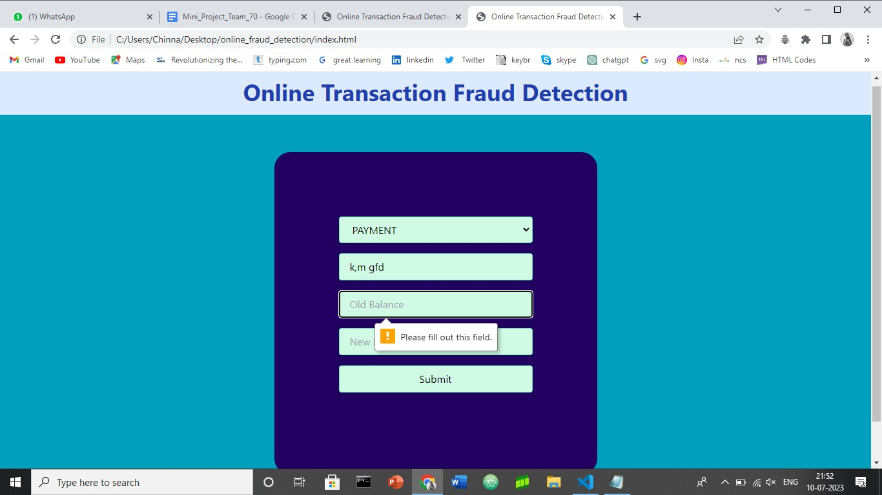

Slide 13
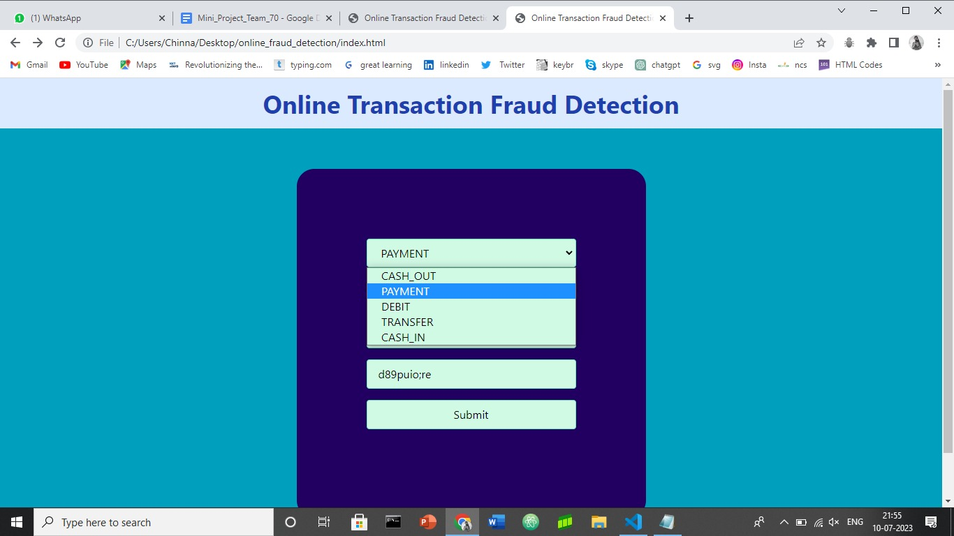

Slide 14
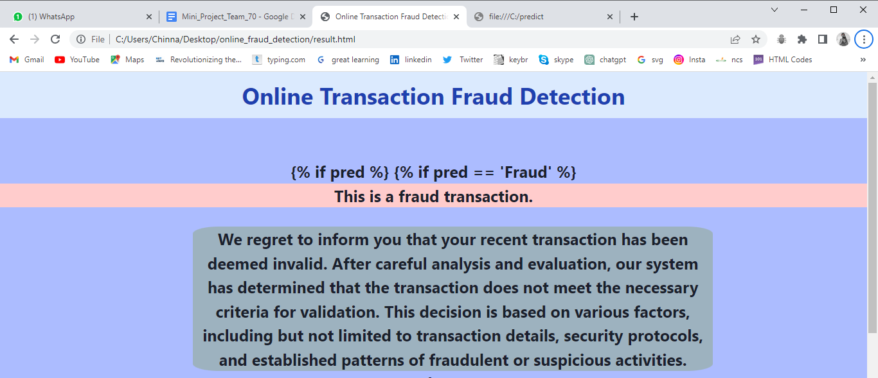

Slide 15
Conclusion
The project successfully demonstrated the effectiveness of the developed model in detecting and preventing fraudulent transactions in real-time.
By leveraging advanced algorithms and data analysis, the system showed promising results in accurately

Slide 16
Future scope
The future scope tries to detect fraudulent transaction before transaction succeed .
Present a Behavior and Location Analysis(BLA).
To detect frauds by considering a cardholder’s spending habit.

Slide 17


